Slide 1
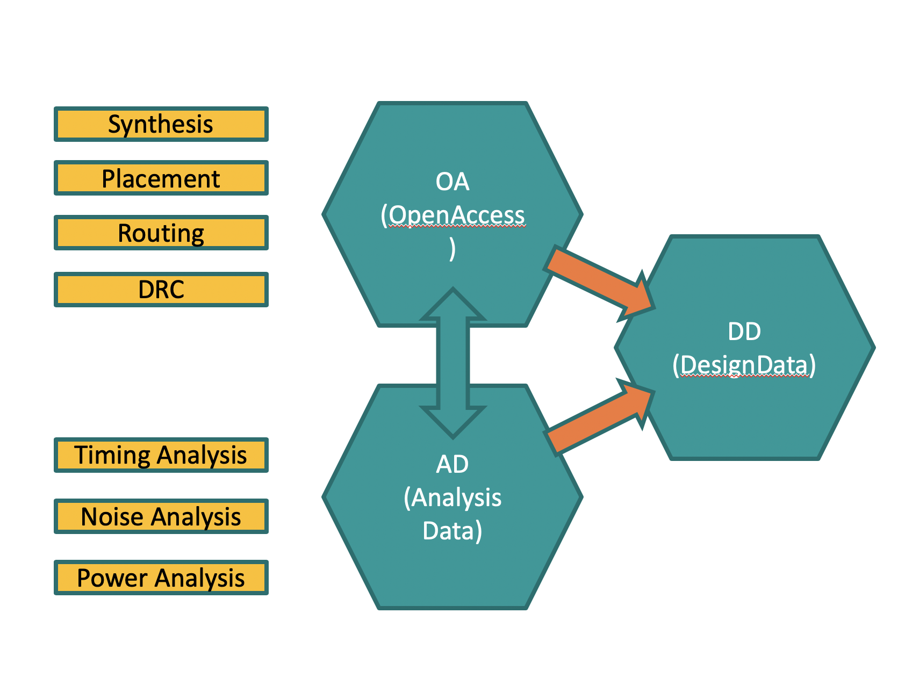
Background – Capturing the DATA
DD as a solution to solve these problems
We need a system in which it is easy to ask questions at the intersection of logic / timing / placement / routing
We cannot be restricted to asking questions only during tool flow
Re-loading the design after construction can be laborious
We want this system to be clean (minimal dependencies required to load data) and to operate well with Python and C++
DD stores all of its data in a single file for convenient management
DD memory/disk footprint is over 10x smaller than the memory consumed by the construction flows
DD load/init times are over 100x faster
DD can load netlist, timing, placement, routing of a one million net design in less than one minute
Notes:
Few people in EDA with working knowledge of logic/timing/placement/wiring APIs.

Slide 2
Tool Flow Correlation
DD
DD
DD
DD
DD
Accuracy
Speed
Density of DD file allows multiple state snapshots
Compare early predictions against later more accurate modeling
Sibling DD files may be linked enabling easy difference analysis

Slide 3
Architecture
EDA toolset (synthesis, timing, power,noise)
DD signal
DD tpt
Tool independent
abstraction
layer (C++)
Data import API layer
(C++)
Python Bindings
DD Box/Pin/Net
We have done this for
IBM/EDA toolset (IDM, EinsTimer, PDS)
Read-only
Opportunities for Open-Source Academic/EDA SW collaboration
OA➔DD
Analytics Ecosystem
Core model development
OpenTimer ➔DD
ML using DD

